Slide 1




AN INTRODUCTION TO GIT, GITHUB, AND VsCode
20 Mars 2024
AHME
Ahmed Charef
OC T OC AT !

Slide 2



BEFORE WE GET STARTED
1. Sign-up for GitHub Pro with a student developer pack:
education.github.com/pack
2. Download and install Vscode
code.visualstudio.com

Slide 3
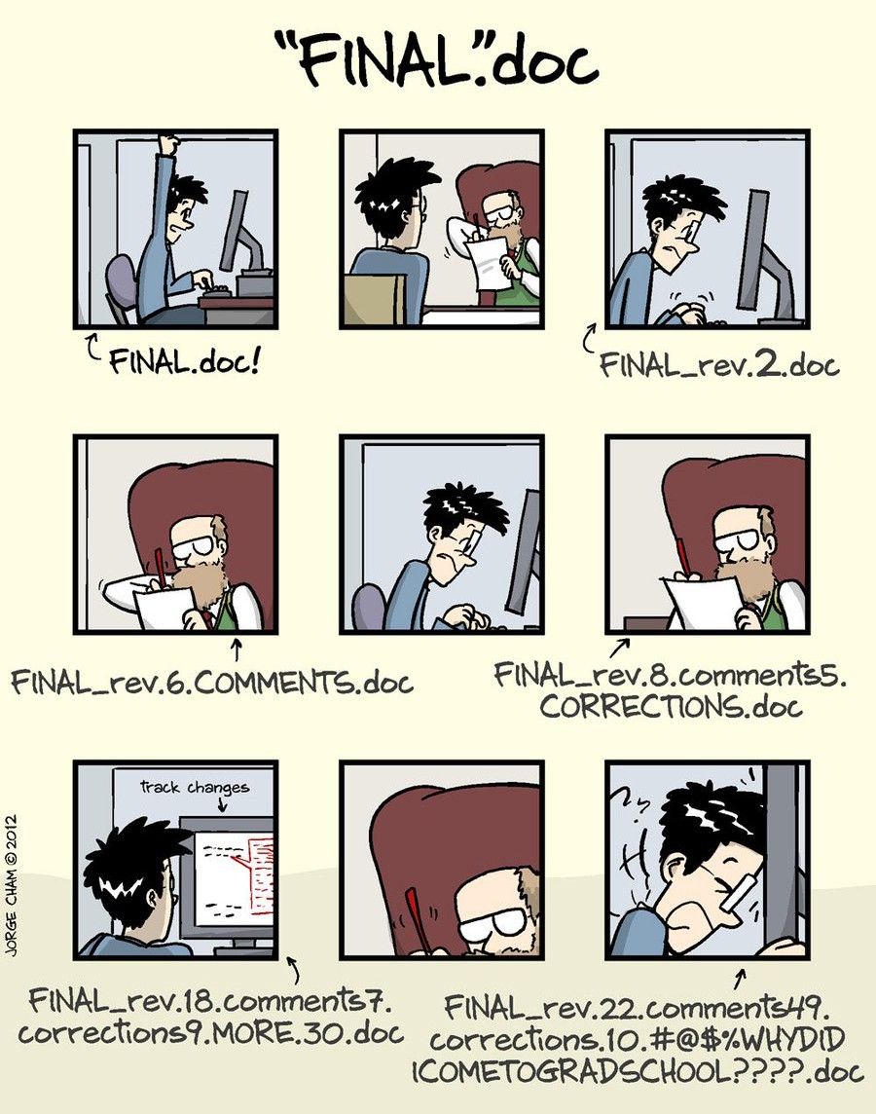
WHAT IS VERSION CONTROL AND
WHY USE IT?

Slide 4
VERSION CONTROL
A system that manages and keeps records of changes made to files
Allows for collaborative development
Allows you to know who made what changes and when
Allows you to revert any changes and go back to a previous state

Slide 5


WHAT ARE GIT AND GITHUB?
Git and GitHub are two different things
Git is a particular implementation of version control originally designed by Linus Torvalds in 2005 as a way of managing the Linux kernel. Git manages the evolution of a set of files – called a repository or repo
Essentially, the language of version control
GitHub is an online hub for hosting Git repositories and provides GUI software for using Git
GitHub complements Git by providing a slick user interface and distribution mechanism for repositories. Git is the software you will use locally to record changes to a set of files. GitHub is a hosting service that provides a Git-aware home for such projects on the internet
GitHub is like DropBox or Google Drive, but more structured, powerful, and programmatic

Slide 6
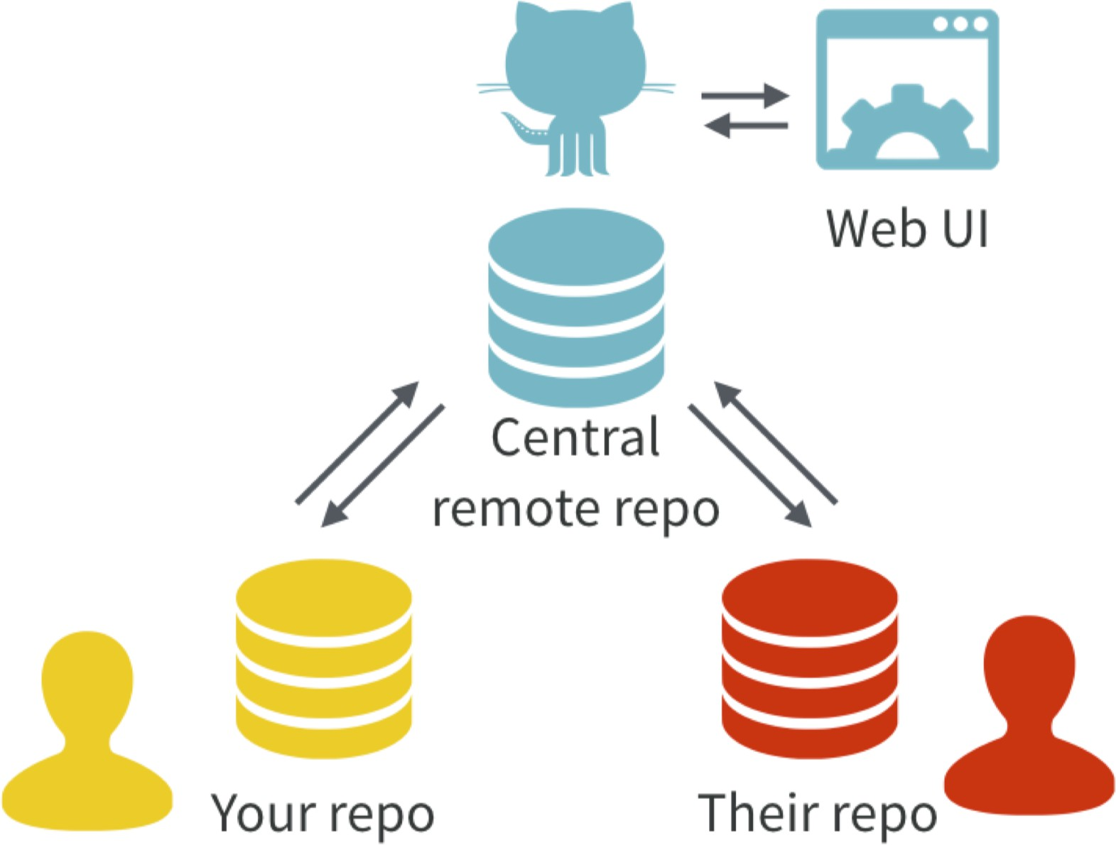
With Git, all contributors have a copy of the repo, with all files and the full history. It is typical to stay in sync through the use of a central remote repo, such as GitHub. Hosted remotes like GitHub also provide access to the repo through a web browser.

Slide 7
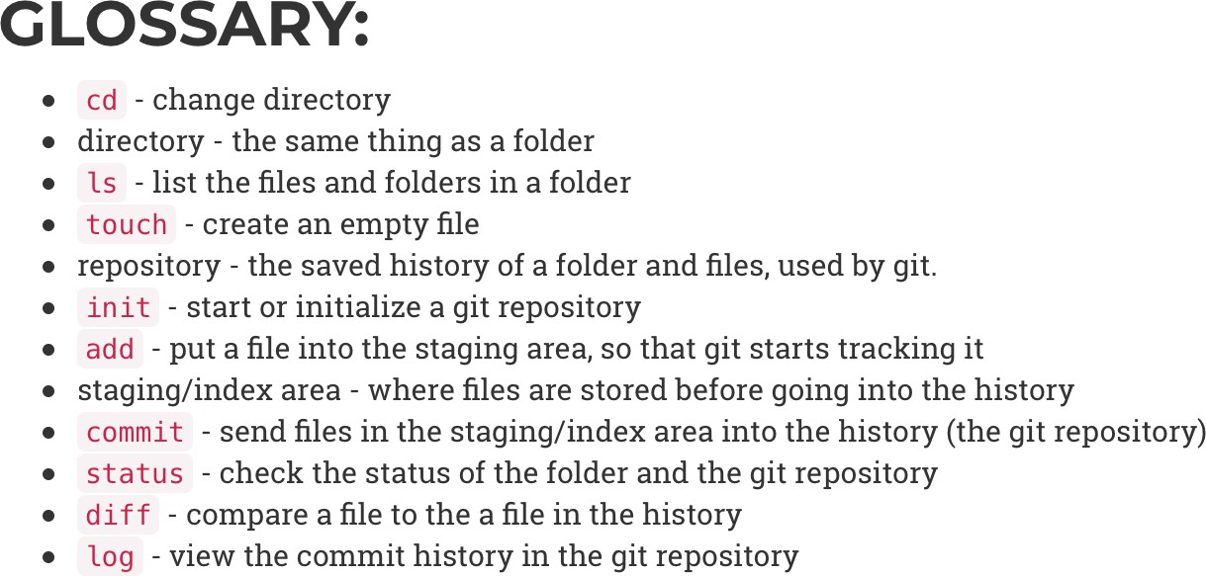
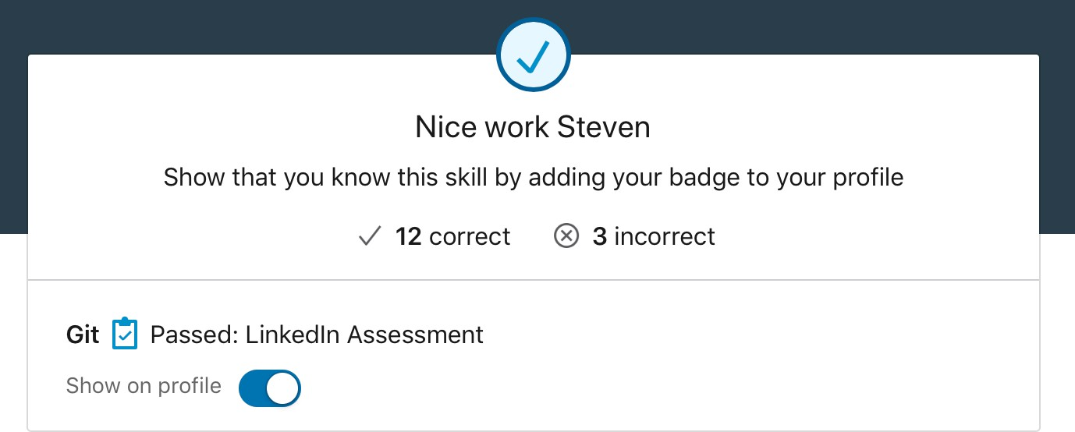
GIT CAN BE COMPLICATED AT FIRST BUT IS EASY TO LEARN
Here are some great places to go to learn Git:
Udemy - Git complete step-by-step guide
TeamTreehouse - Git Basics
Codecademy - Learn Git
Lynda.com - Git Essential Training
atlassian.com - Getting Git Right

Slide 8
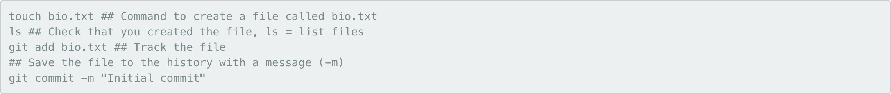
MANY GIT COMMANDS CAN BE
EXECTUED WITH GITHUB

Slide 9
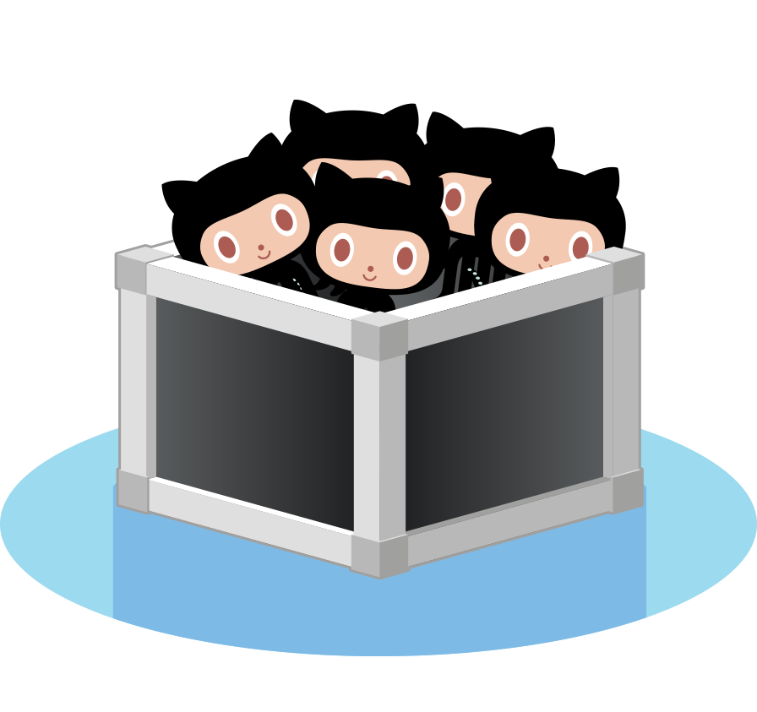
KEY CONCEPTS: REPOSITORIES
Often referred to as a repo, this a collection of all your files and the history of those files (i.e. commits)
Can live on a local machine or on a remote server (e.g. GitHub)
The act of copying a repo from a remote server is called cloning
Cloning from a remote server allows teams to work together
The process of downloading commits that don’t exist on your machine from a remote server is called pulling changes
The process of adding your local changes to a remote repo is called pushing changes

Slide 10

KEY CONCEPTS: COMMIT
Commits contain 3 pieces of information:
Information about how the files have changed from the previous commit
A reference to the commit that came before it, known as the parent commit
An SHA-1 hash code (e.g. fb2d2ec5069fc6776c80b3ad6b7cbde3cade4e)

Slide 11

HOW DOES GIT WORK: KEY CONCEPTS
Git keeps track of your files using “snapshots” that record what the files in your repository look like at any given point in time
You decide when to take a snapshot and of what files, this is known as a commit
Can be used as noun or verb
“I commited code”
“I just made a new commit”
Have the ability to go back and visit any commit
A project is made up of a bunch of commits

Slide 12
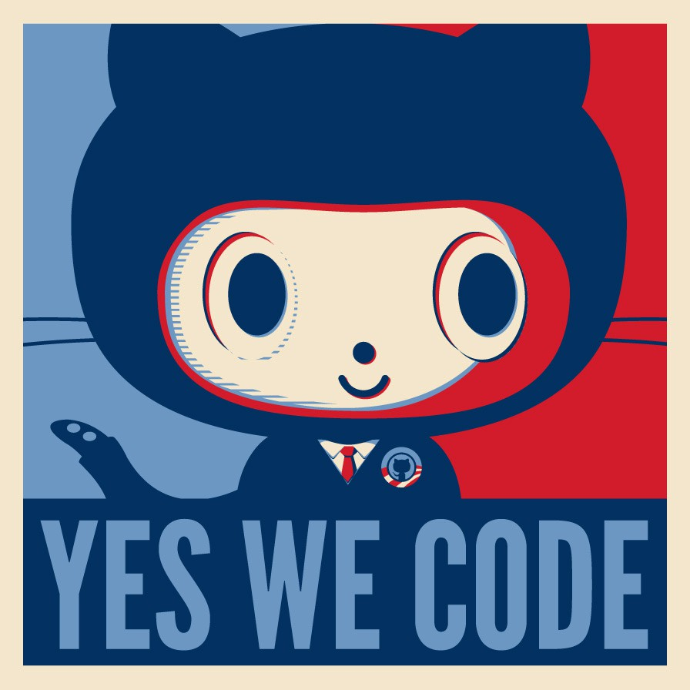
DEMO
Repurposing version control software for science represents a transparent, replicable, and streamlined process that fosters responsible collaboration

Slide 13
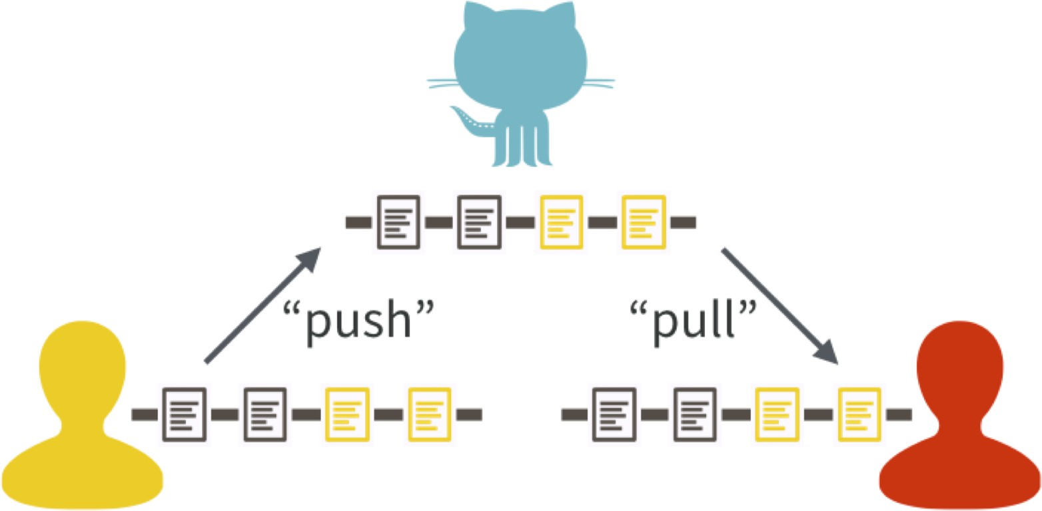
One contributor has made two new commits and updates the master copy on GitHub with a push. Another contributor stays up-to-date with a pull from GitHub.

Slide 14

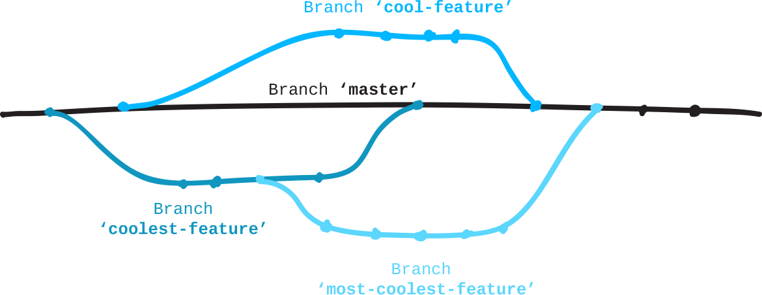
KEY CONCEPTS: BRANCHES
All commits live on a branch
There can be many branches
The project’s main branch is called the master

Slide 15
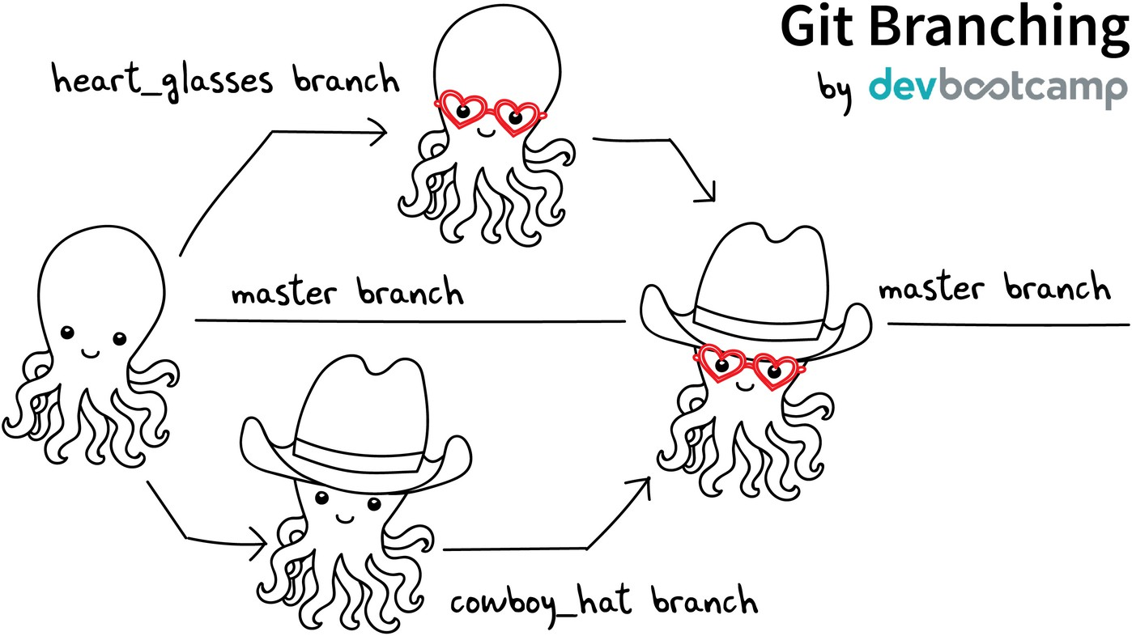

Slide 16

KEY CONCEPTS: README.MD
Collaborate responsibly! Every repository should be initialized
with a
README.MD
file
This is where you detail all the information about the project so that the work can be understood and recreated by another student or collaborator
Arguably the most important file in your repo
Use markdown syntax to make your file clear and easy to read

Slide 17
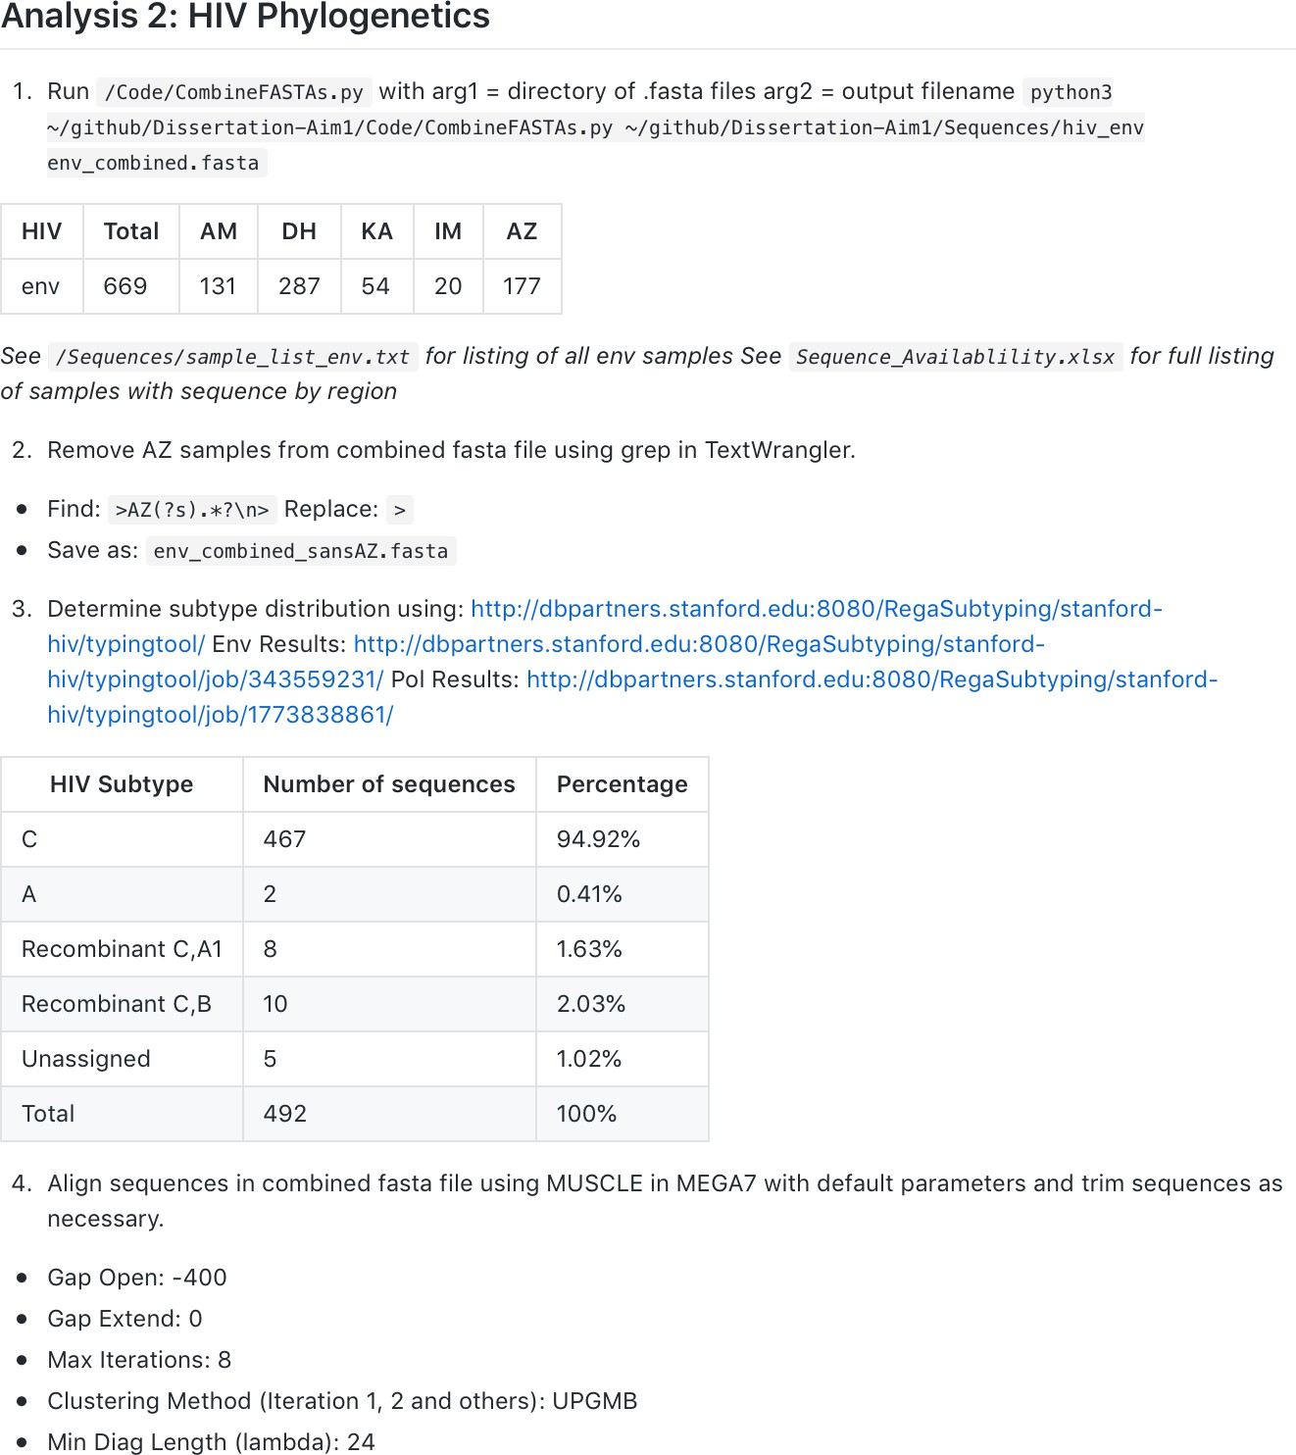
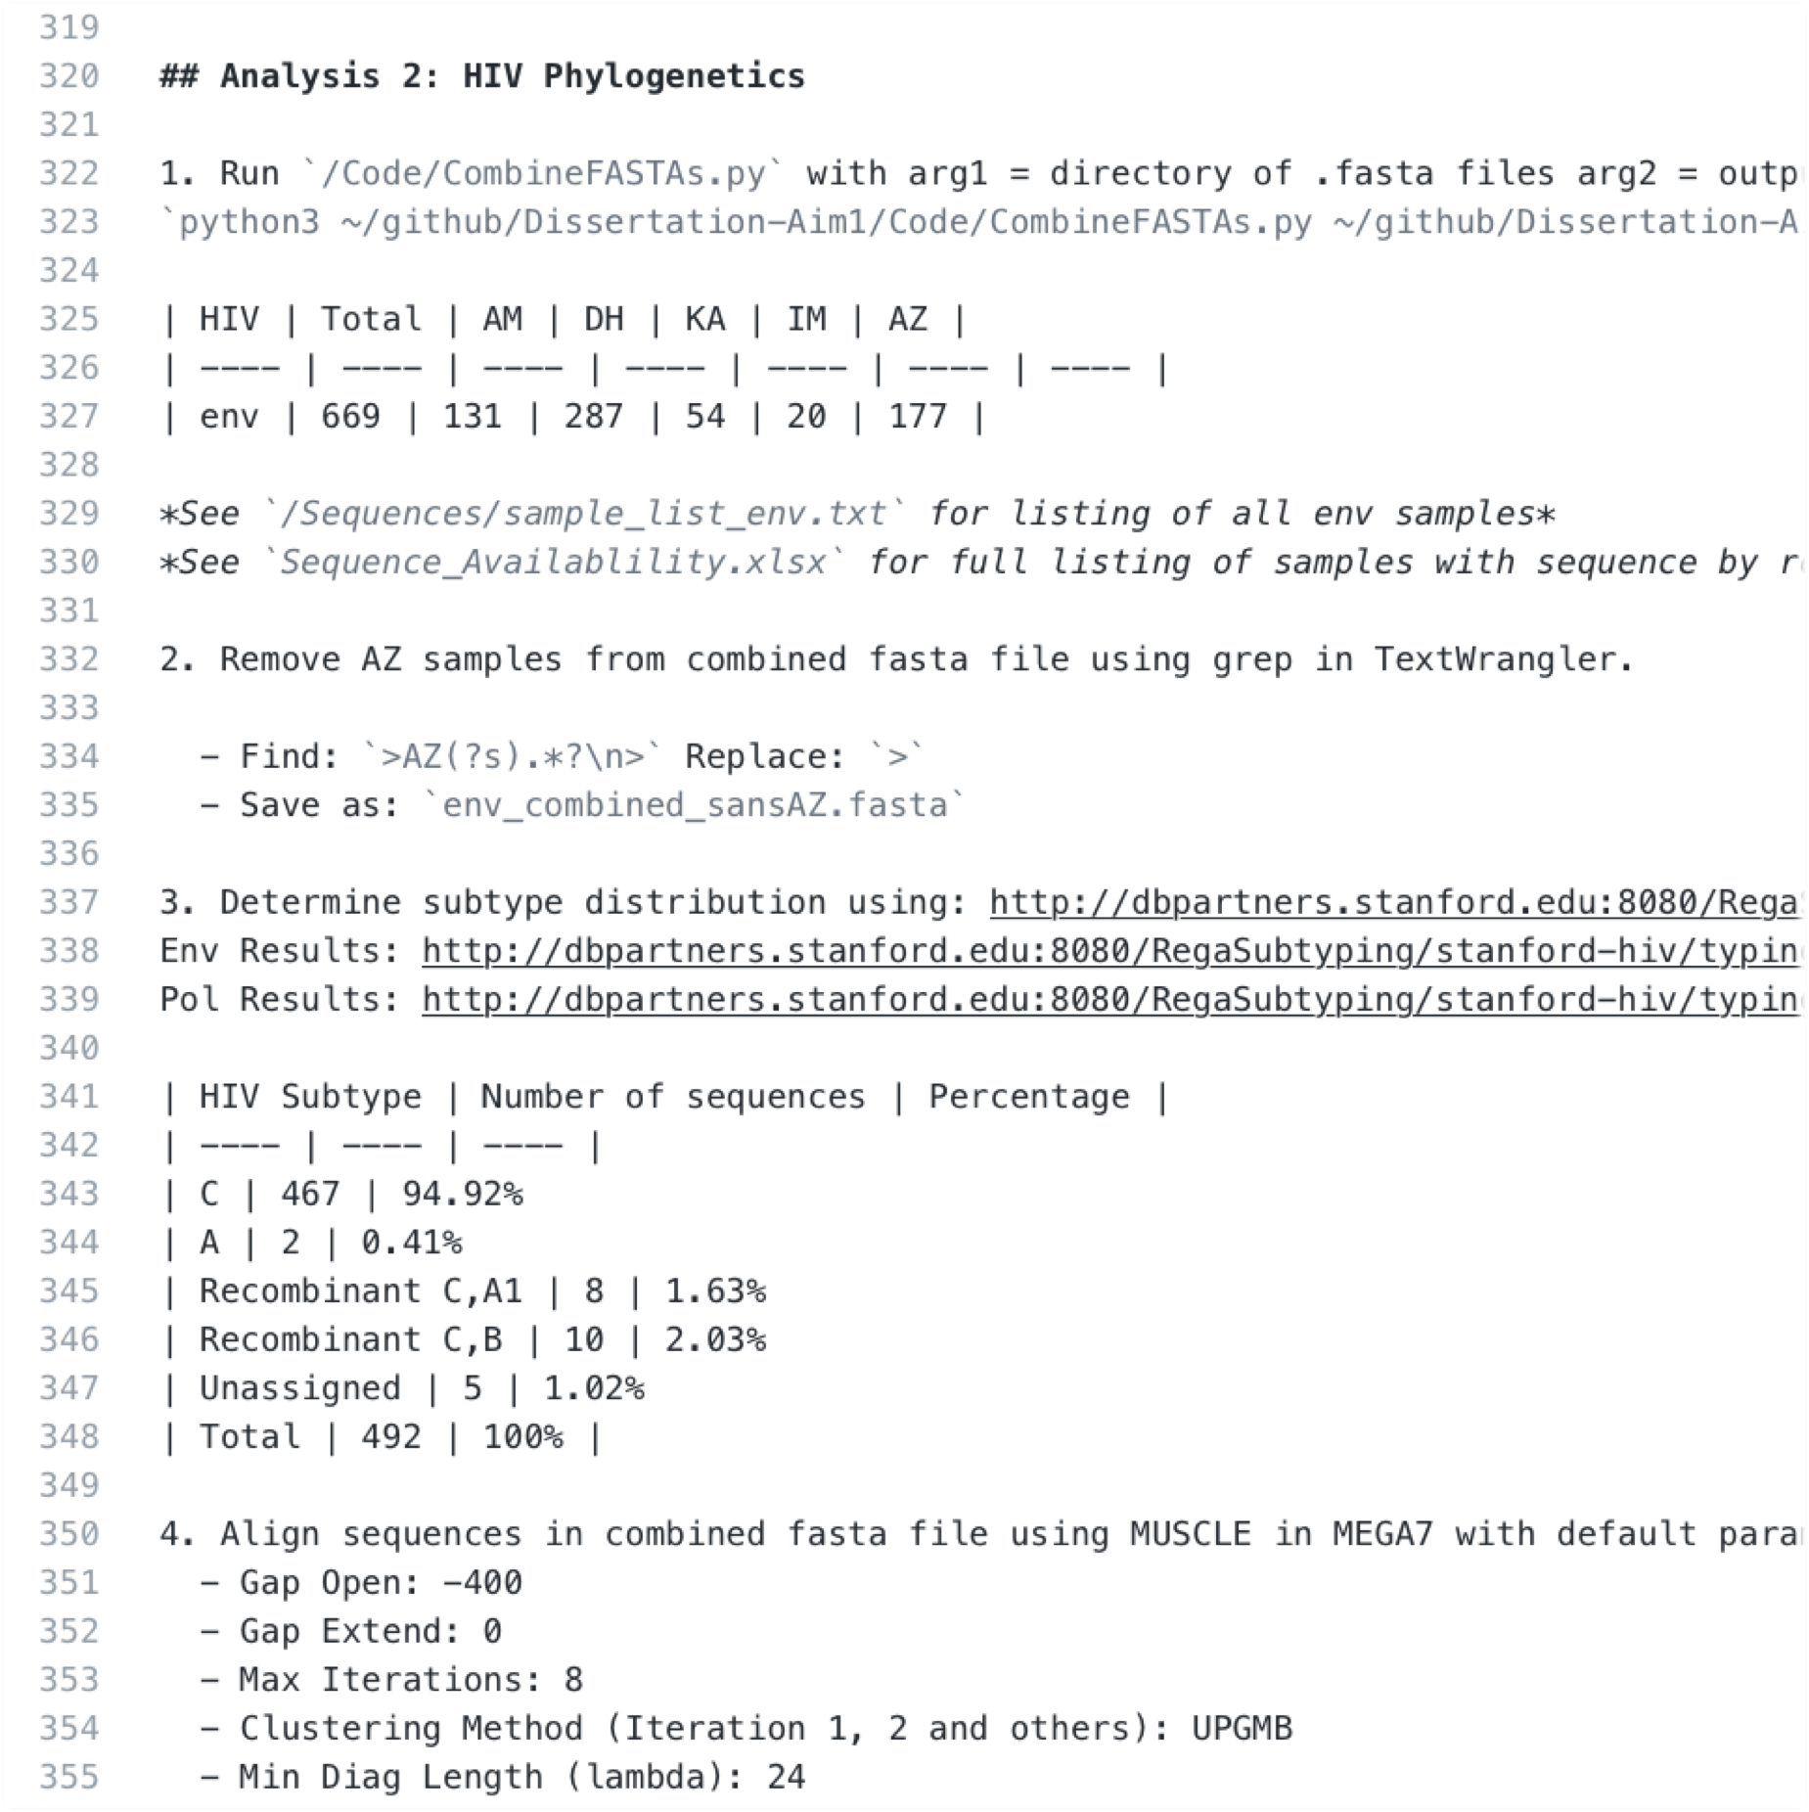

MARKDOWN

Slide 18
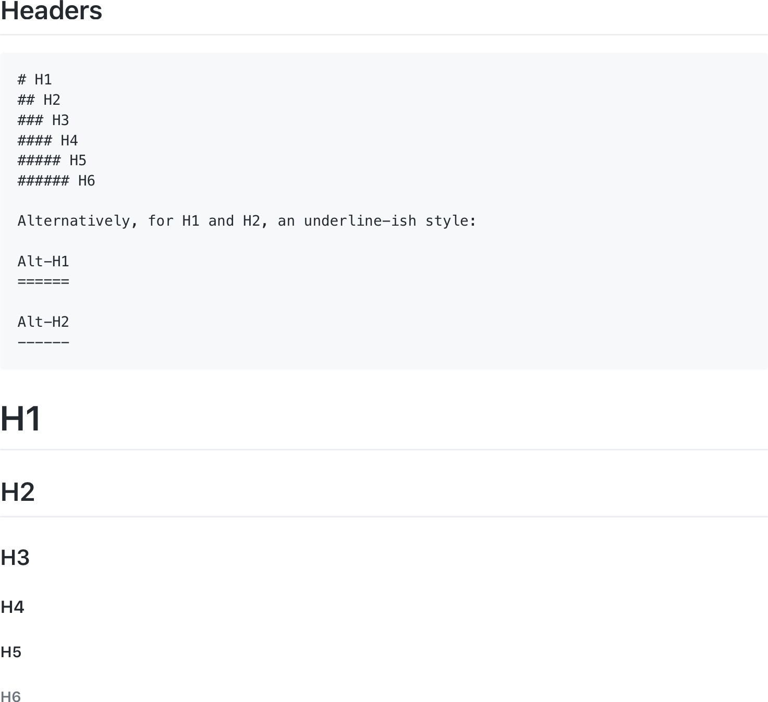
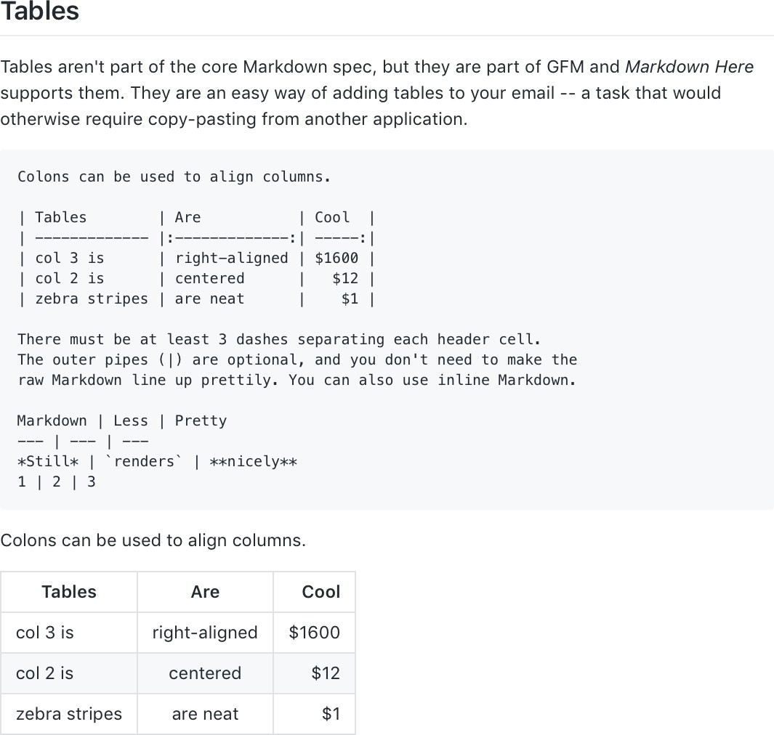
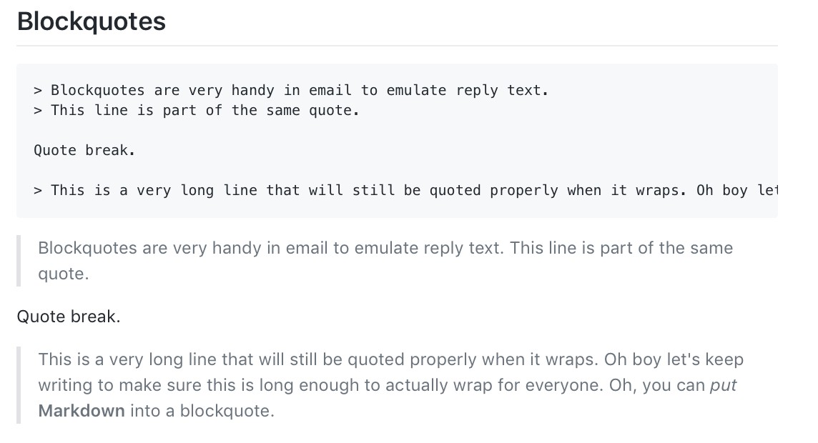
MARKDOWN
Further reading:
github.com/adam-p/markdown-here/wiki/Markdown-Cheatsheet/

Slide 19
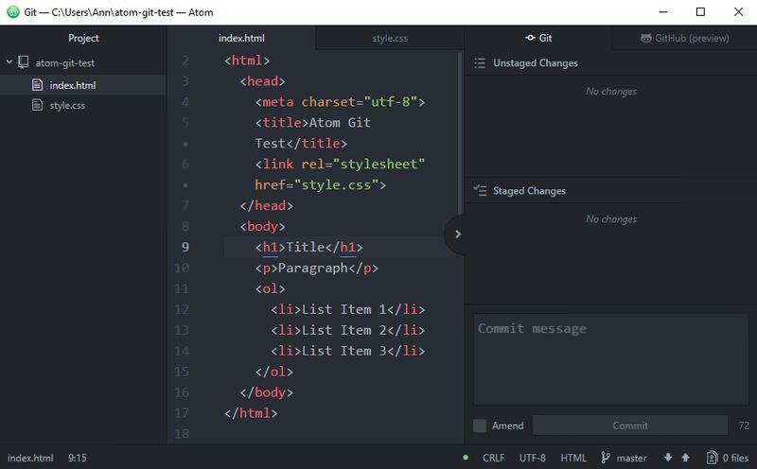
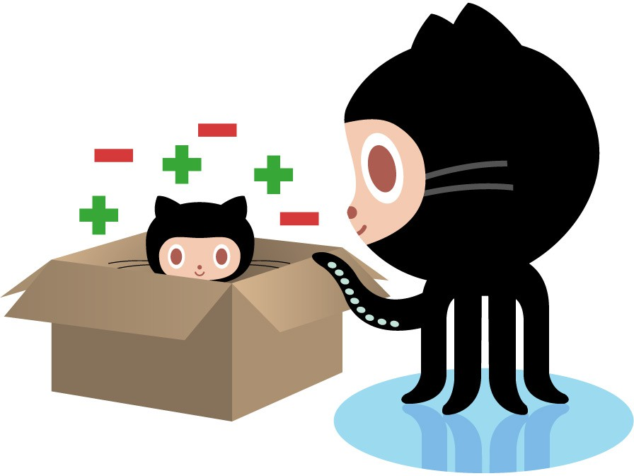

KEY CONCEPS: MAKING A COMMIT
The process:
Make some changes to a file
Use the
git add
command or Atom to
add files to the staging area
Type a commit message (that shortly describes the changes you made since the last commit) into the commit message box, and click
the Commit button.

Slide 20
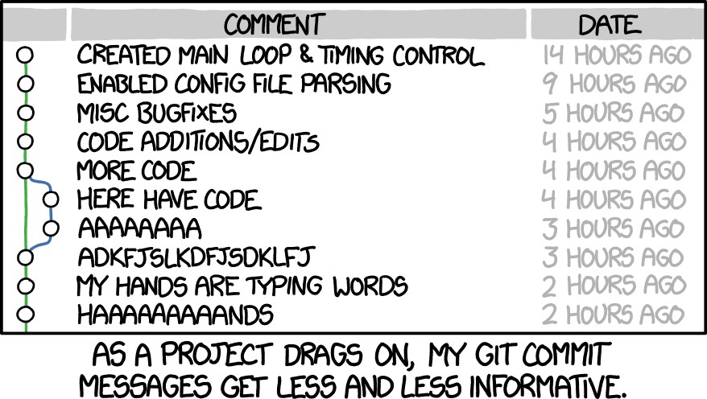
WRITING A GOOD COMMIT MESSAGE
The 7 rules of a great commit message:
Separate subject from body with a blank line
Limit the subject line to 50 characters
Capitalize the subject line
Do not end the subject line with a period
Use the imperative mood in the
subject line
Wrap the body at 72 characters
Use the body to explain what and
why vs. how

Slide 21

A FEW SETUP TIPS
Follow steps to create an SSH key on your machine and associate it with your GitHub account: https://help.github.com/en/articles/generating-a-new-ssh-key-and-adding- it-to-the-ssh-agent
Open the Git panel in Atom (CTRL+SHFT+9) and log in
Execute commands by opening the command pallet (SHFT+CMD+P)
Type clone into the command pallet and paste a link from GitHub to setup a local copy of that repository

Slide 22

A FEW SETUP TIPS
Make sure your email address is associated with Git so that commits are linked to the same GitHub account

Slide 23

ADDITIONAL RESOURCES
Official git site and tutorial:
https://git-scm.com/
GitHub guides:
https://guides.github.com/
Command cheatsheet:
https://training.github.com/kit/ downloads/github-git-cheat-sheet.pdf
Mardown Cheatsheet:
https://github.com/adam-p/markdown-here/wiki/Markdown-Here-Cheatsheet
Interactive git tutorial:
https://try.github.io/levels/1/challenges/1
Visual/interactive cheatsheet:
http://ndpsoftware.com/git-cheatsheet.html

